Slide 1
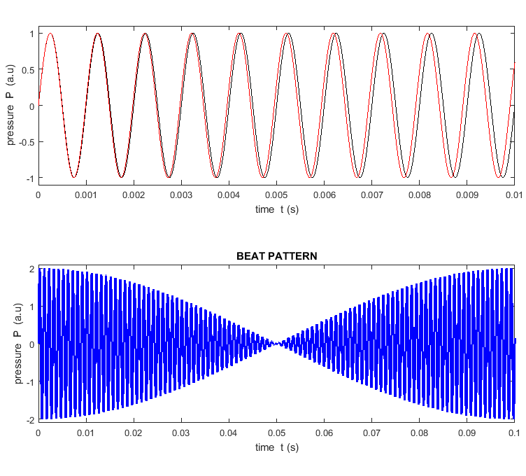

Slide 2
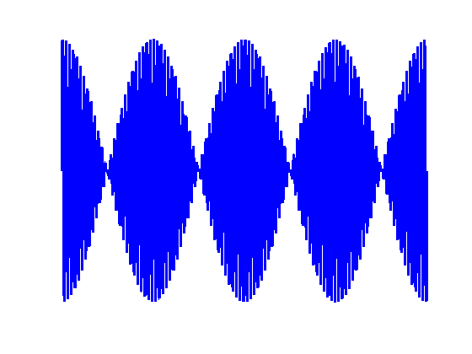
loud
quiet
1 beat

Slide 3
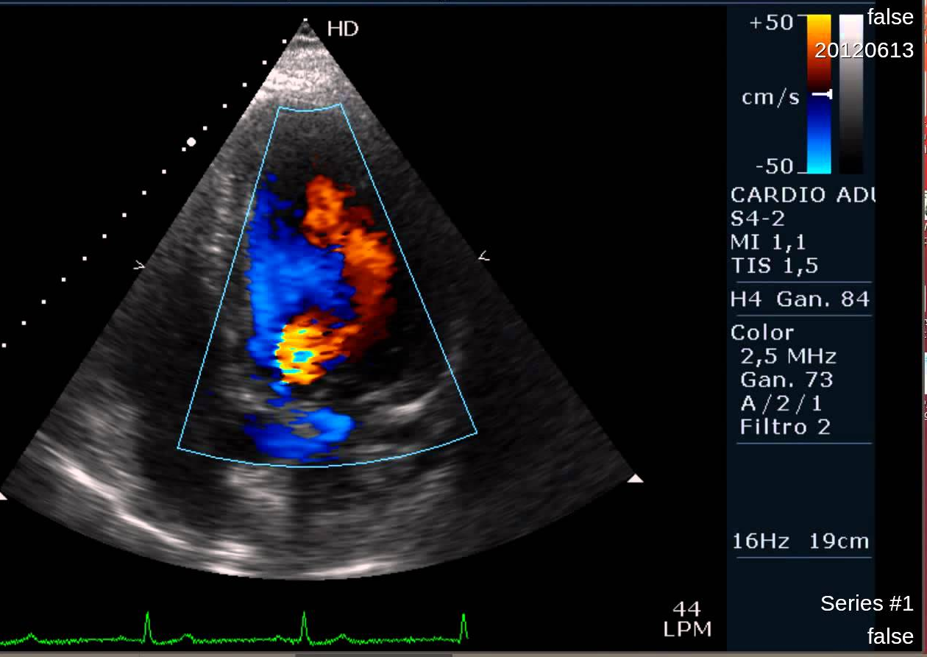
colour gives the speed of blood flow

Slide 4
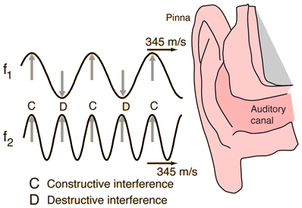

Slide 5
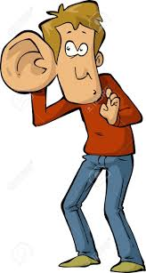

Slide 6
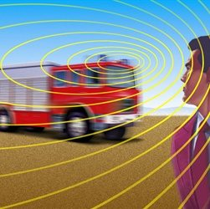
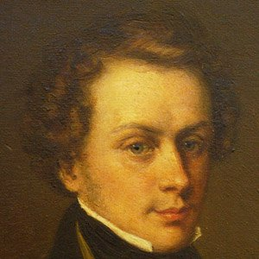

Slide 7
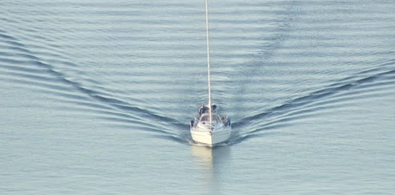
Is the boat moving slow or fast? Explain

Slide 8
ambulance (s)
car (o)
source approaching observer f_{o} ↑
observer receding from source f_{o} ↓
car (o)
ambulance (s)
observer approaching source f_{o} ↑
source receding from observer f_{o} ↓
car (o)
ambulance (s)
observer approaching source f_{o} ↑
source approaching observer f_{o} ↑
ambulance (s)
car (o)
observer receding from source f_{o} ↓
source receding from observer f_{o} ↓

Slide 9
train (s)
person (o)
source approaching observer f_{o} ↑
reflected sound (s) at the same frequency as heard by the person: no change in frequency upon reflection
train (o)
observer approaching source f_{o} ↑

Slide 10
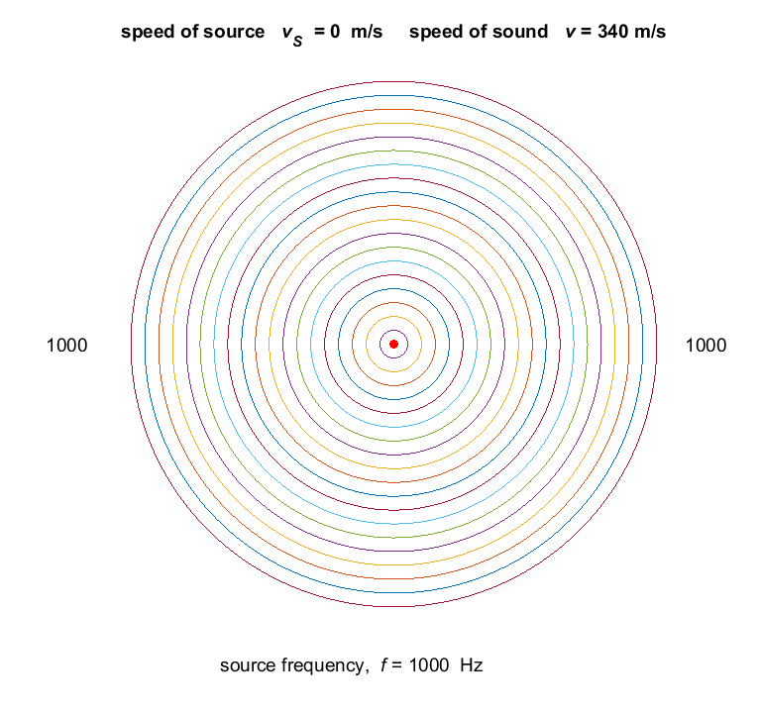

Slide 11
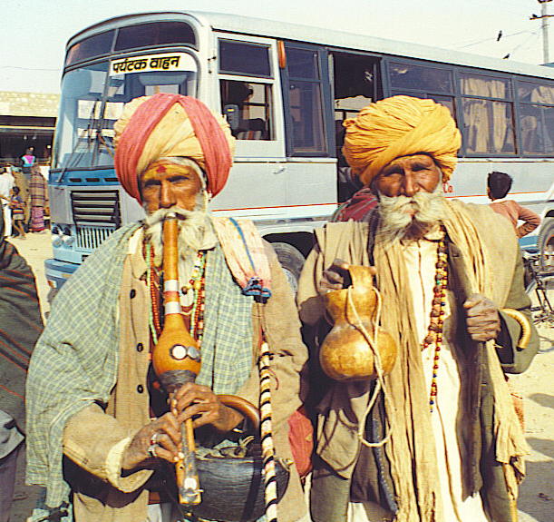

Slide 12

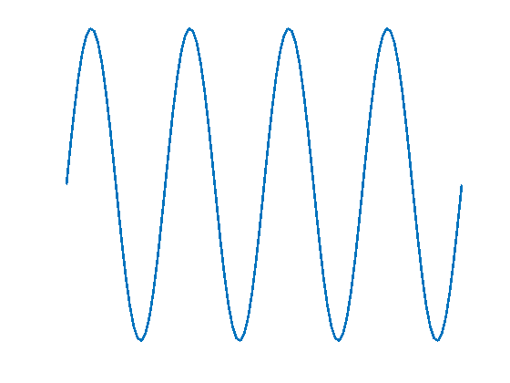
trough of wave
crest of wave
wavelength λ
amplitude A
crest
disturbance s
s = 0
x
trough
wavelength λ
water wave at one instance of time

Slide 13
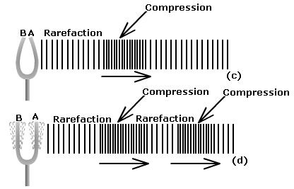

Slide 14
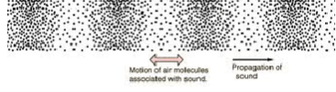
particle vibrates
back to forth
direction of propagation
+P
pressure fluctuations P
P = 0
X
-P
rarefaction
decreased pressure
compression
increased pressure
right
particle
displacement s
s = 0
X
left
The pressure and particle displacement are π/2 rad out of phase

Slide 15
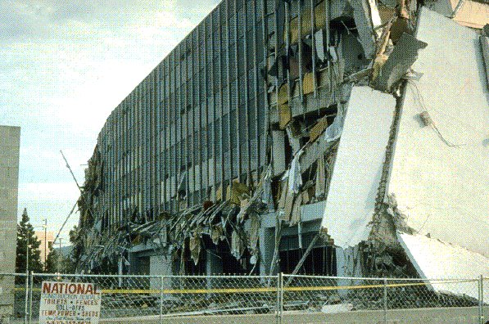
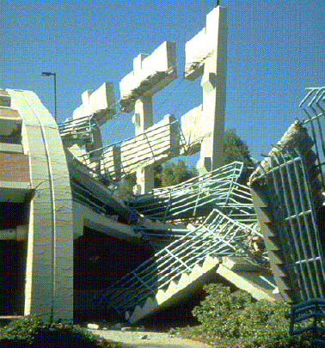

Slide 16
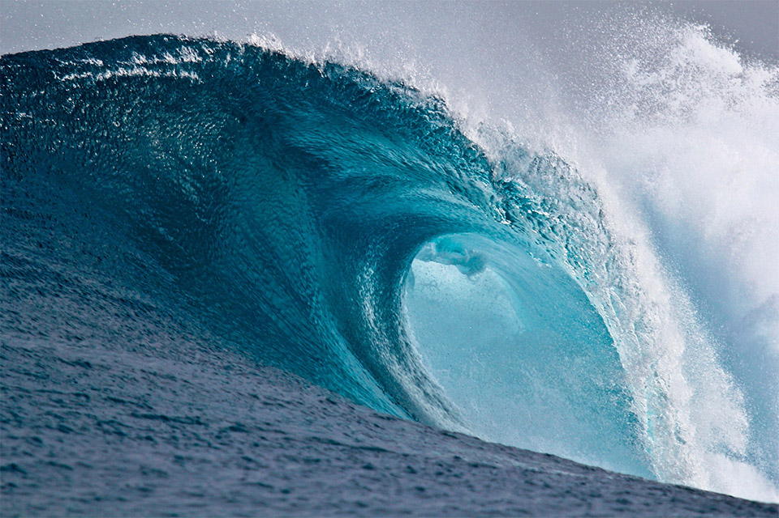
v
How a wave breaks.
Surface water waves - combination of transverse & longitudinal motions & at lower depths only longitudinal motion. In deep water, the wave action decreases with depth.
When a wave approaches the shore, the water drags at the bottom and is slowed down, while the crests move ahead a greater speed and spill over the top.

Slide 17
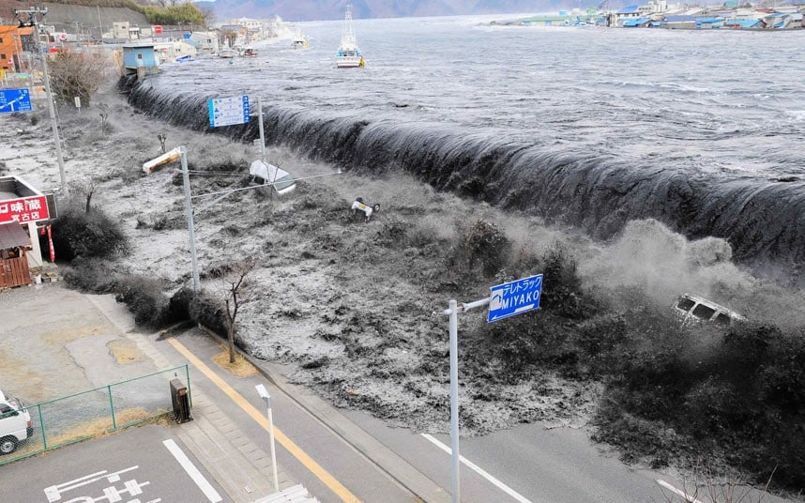
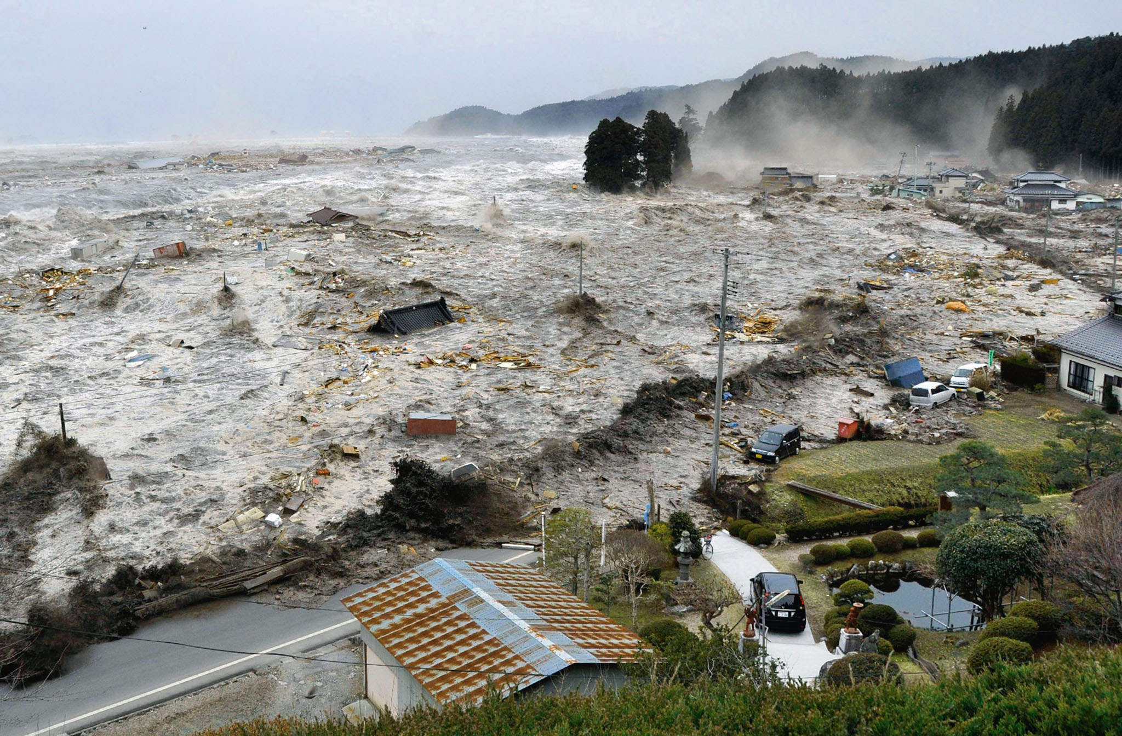
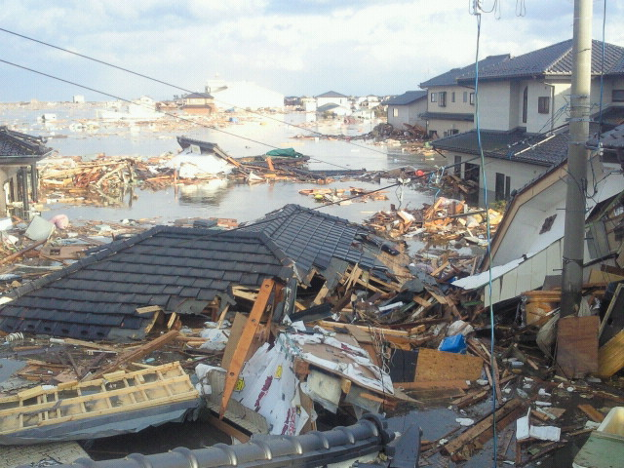

Slide 19
larger b value – greater damping
driving frequency
natural frequency

Slide 20
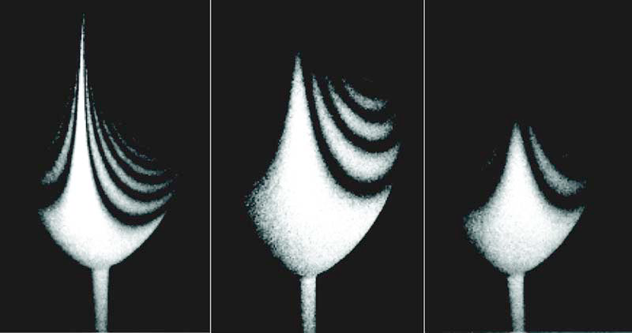
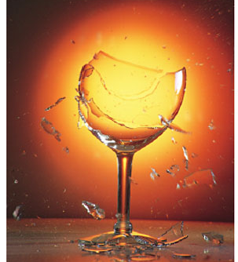

Slide 21
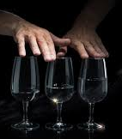

Slide 22
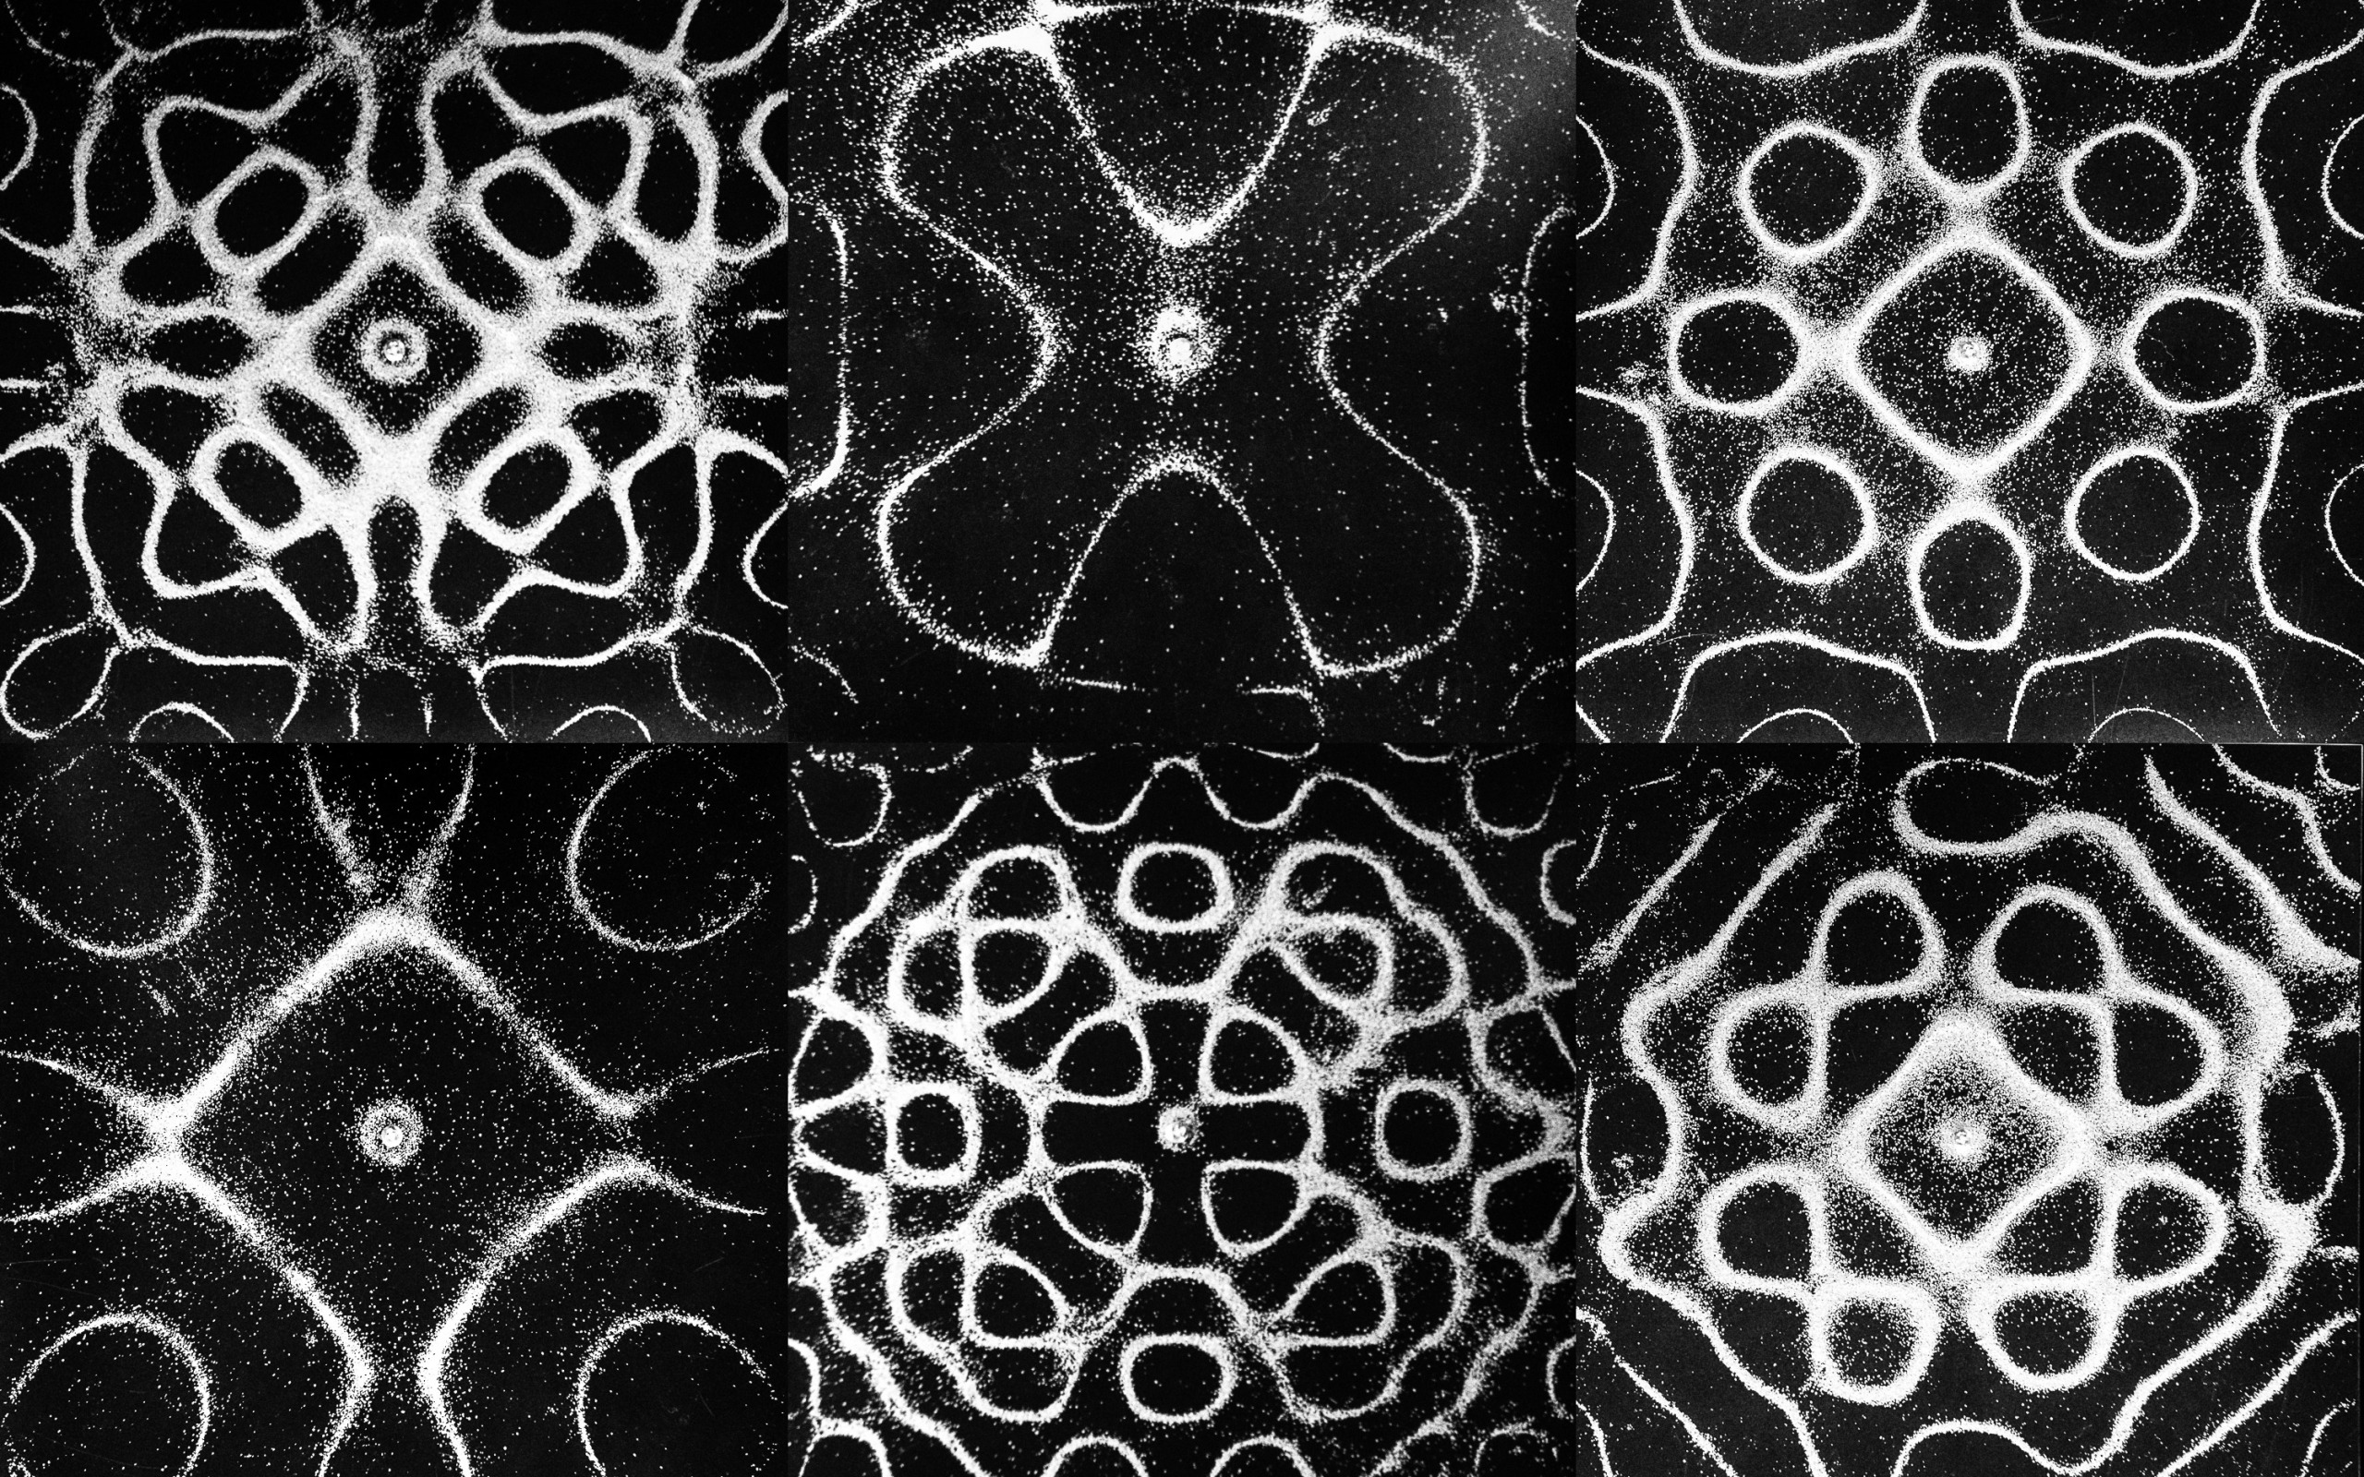
Chladni Plates: standing wave patterns occur when driven at a natural frequency of vibration
antinode
max disturbance
node
min disturbance
sand accumulates at the location of the nodes where there is only a small movement of the vibrating the plate

Slide 23
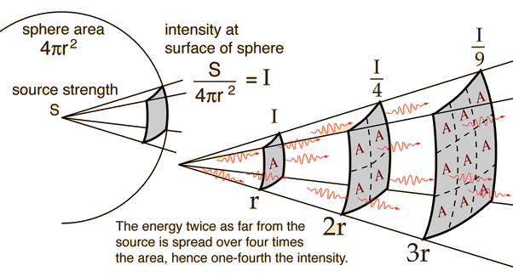
intensity at surface of sphere
Energy three times as far from the source spreads over 9 times the area, hence 1/9 of the intensity

Slide 24
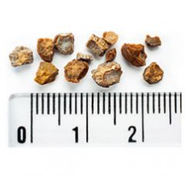
cm

Slide 25
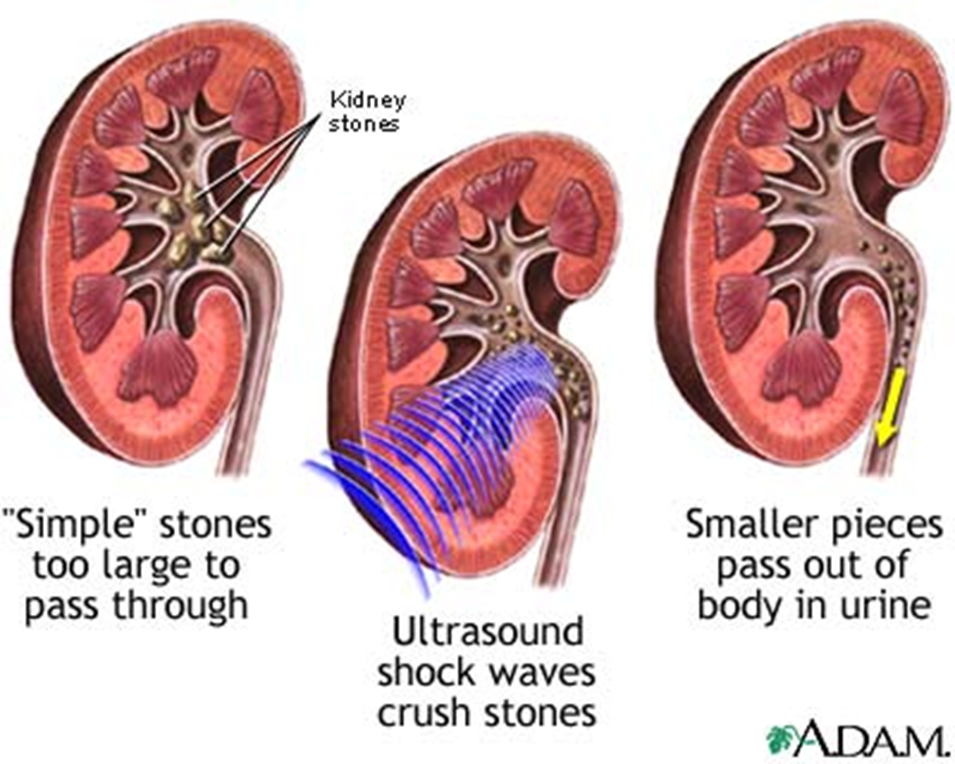

Slide 26
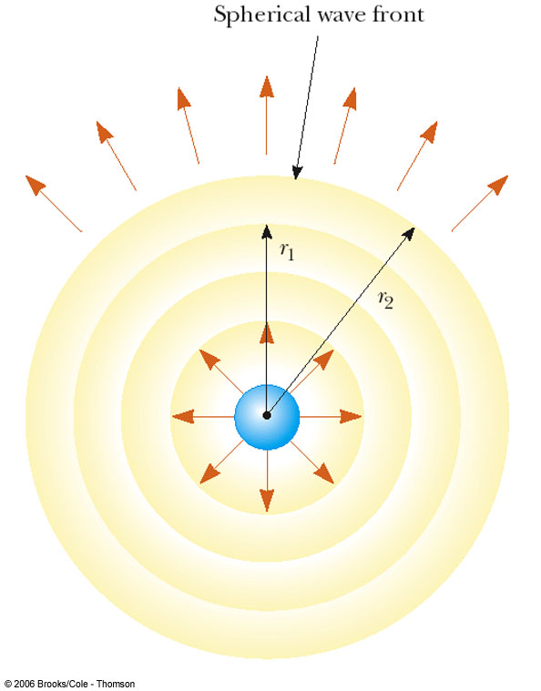
spherical wave front
R₁
R₂

Slide 27
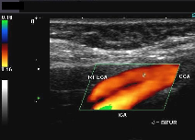

Slide 28
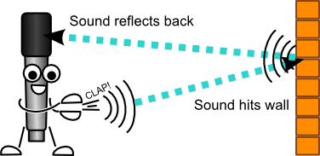
sound wave reflected off wall
reflected wave
transmitted wave’s energy is absorbed by the wall increasing its temperature
incident wave

Slide 29
Law of Reflection
normal to surface
incident ray
reflected ray
angle of incidence
reflected
wave front
angle of reflection
incident
wave front
smooth surface
N.B. angles measured
w.r.t. normal
mirror

Slide 30
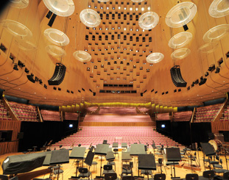
panelling for absorption
reflectors
interior Sydney Opera House

Slide 31
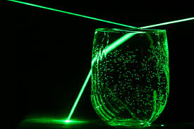

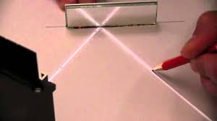
reflection
refraction

Slide 32
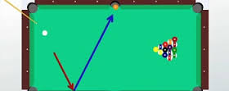

Slide 33
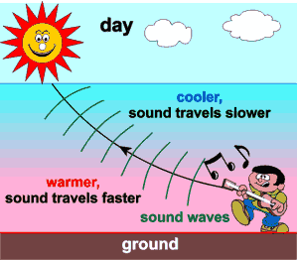
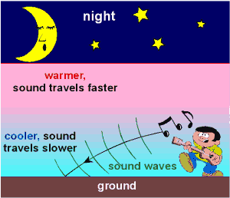

Slide 34
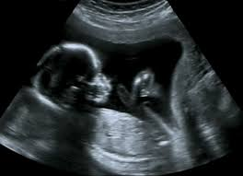
human fetus is clearly defined using short
wavelength sound waves

Slide 35
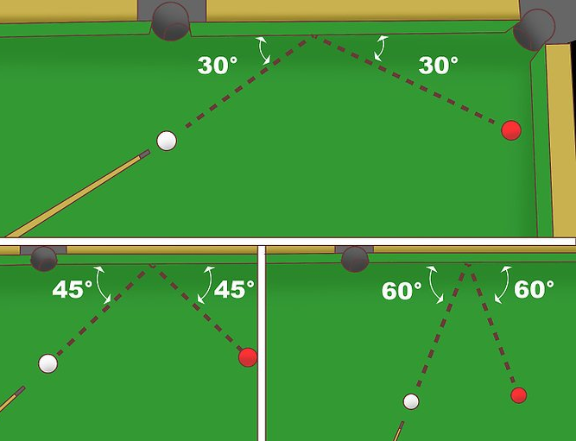
In physics terminology, what is wrong with the pictures?

Slide 36
normal
normal
refracted ray bent away normal
refracted ray bent towards normal
critical angle
no refracted ray:
total internal reflection

Slide 37
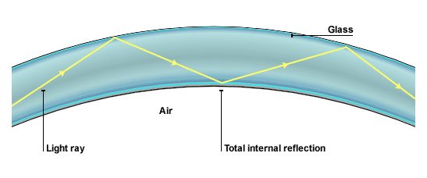
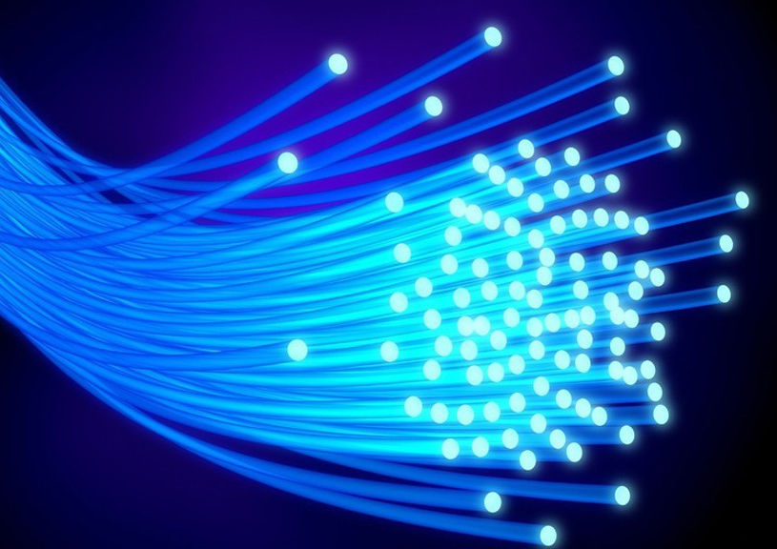
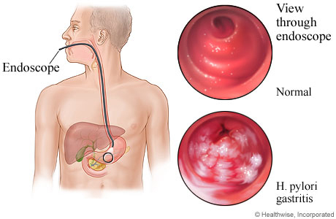
endoscope
endoscope view
glass
normal
air
light beam
total internal
reflection
H. pylori
gastritis

Slide 38
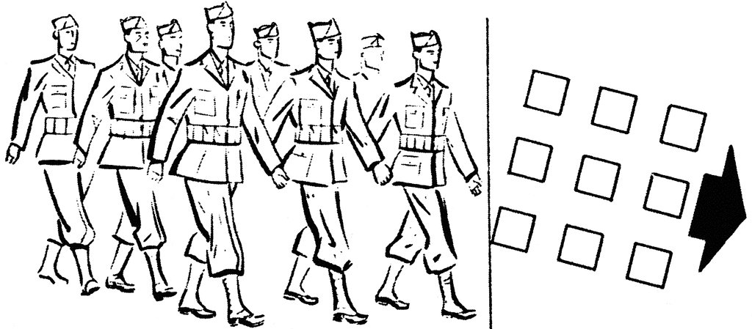
medium 1: firm ground
normal
medium 2: muddy ground

Slide 39
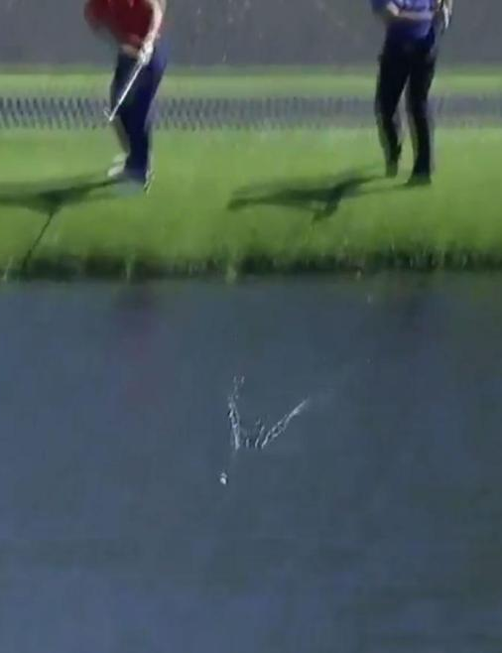

Slide 40

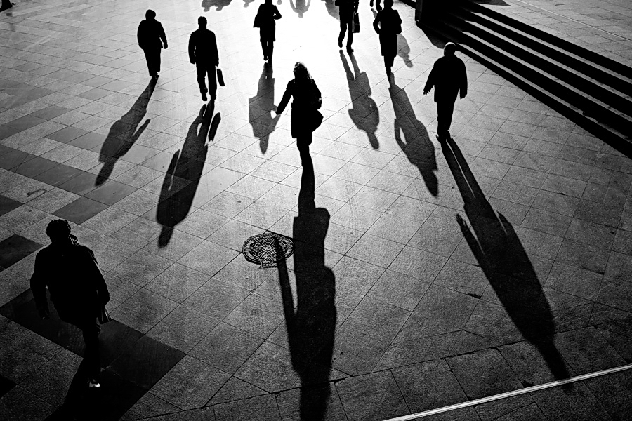
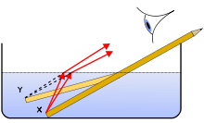
Refraction: bending of light at surface
sharp shadows implies light travels in straight lines
virtual object
real object
A small bundle of light rays come from each single point and enter your eye

Slide 41
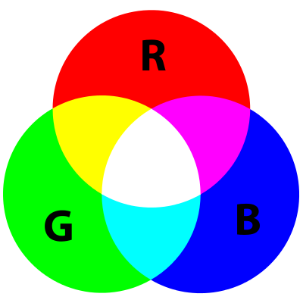
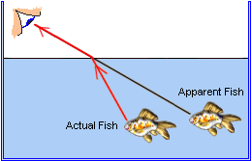
virtual
image
actual position

Slide 42
air
n₁ = 1.0
incident ray
refracted ray
glass
n₂ = 1.5
transmitted ray
same direction of propagation as incident ray, but, the transmitted ray is shifted to the left

Slide 43
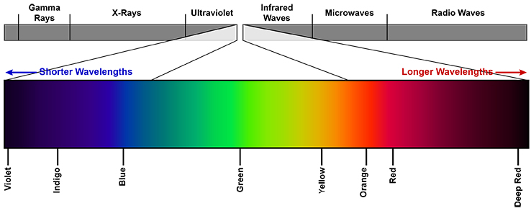
gamma rays
UV
ultraviolet
IR
infrared
microwaves
X rays
radio waves
visible
violet
indigo
blue
green
yellow
orange
red
deep
red
400 nm
500 nm
600 nm
700 nm

Slide 44
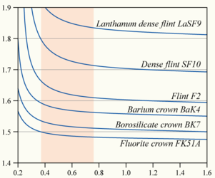
refractive index n
wavelength λ (μm)

Slide 45
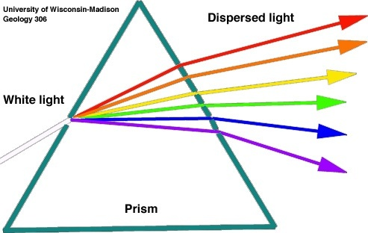
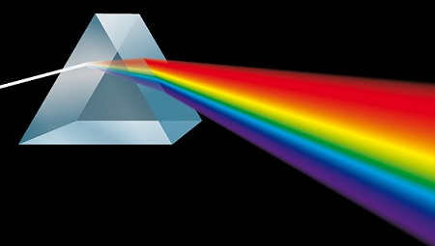

dispersion
red
white
light
orange
yellow
green
colours of the rainbow
blue
glass
prism
violet

Slide 46






Slide 47


diffuse reflection
light reflected from the rough surface can be seen at both positions when the head is moved
rough paper surface
specular reflection
only when the eye is in this position does the eye see the light from the torch
mirror with smooth surface

Slide 48

person looking at their image in a plane mirror
light appears to be coming along this straight line from the tip of the head
mirror
object
virtual image
h
h
light appears to be coming along this straight line from the toe
d
d

Slide 49

converging lenses
diverging lenses
convex
meniscus
plano-
convex
double
convex
concave
meniscus
plano-
concave
double
concave

Slide 50






Slide 51
lens axis
focal plane
F
principle focus
(focal point)
optical axis
double convex lens
f
focal length

Slide 52
lens axis
focal plane
principle
focal point
F
optical axis
F_{p}
focal point
double convex lens
f
focal length

Slide 53

lens axis
focal plane
F
F
f
focal length
F_{p}
focal point
f
focal length
optical axis

Slide 54

object plane
focal plane
lens axis
focal plane
image plane
h_{o} = 280
F
optical axis
F
h_{i} = 400
f = 200
f = 200
d_{o} = 340
d_{i} = 486

Slide 55
object plane
focal plane
lens axis
focal plane
image plane
F
optical axis
F

Slide 56
image plane
object plane
lens axis
virtual image
F
optical axis
F
focal plane
focal plane

Slide 57
object plane
lens axis
image plane
2f
F
optical axis
F
f
focal plane
focal plane

Slide 58
object plane
lens axis
image plane
2f
F
optical axis
F
f
focal plane
focal plane

Slide 59
virtual image
at infinity
object plane
lens axis
“parallel rays”
F
optical axis
F
focal plane
focal plane

Slide 60

object plane
image plane
virtual image
lens axis
optical axis
F
F
focal plane
focal plane

Slide 61
focal plane
lens axis
optical
axis
F
f

Slide 62
objective lens
eyepiece lens
F_{o}
F_{e}
object
F_{o}
F_{e}
real image
magnified virtual image

Slide 63

eyepiece lens
objective lens
object
real image
F_{o}
F_{e}
F_{o}
F_{e}
magnified virtual image

Slide 64




fly larva
dust
coffee
thread in a needle

Slide 65



incident angles < 24.4º
light is refracted
white light
total internal reflection – all incident angles > 24.4º
total internal reflection – all incident angles > 24.4º

Slide 66



apparent position of Sun
actual light path
through atmosphere
true position of Sun
Why do we get red sunsets?
Why is the Sun oval shaped?

Slide 67

path of light
hot sandy surface
apparent position of object

Slide 68




Slide 69



focus

Slide 70



new
wavefront
new
wavefront
wavefront
wavefront
secondary wavelets:
arc of a circle
reflection
refraction

Slide 71

shadow region
shadow region
shadow region
shadow region

Slide 72


λ
d
wide gap
λ << d
narrow gap
λ > d

Slide 73



electron micrograph
head of a yellow dung fly
mites on our skin

Slide 74
constructive interference at P
+
=
d₁
P
time
waves in phase
path length difference
S₁
d₂
destructive interference at P
S₁
+
=
waves out of
phase by π
time
path length difference

Slide 75



Slide 76



Slide 77




Slide 78

d = 0.16 nm
d = 0.08 nm
slit width d
d = 0.04 nm
d = 0.02 nm
Red light from a helium–neon laser. HeNe laser, is a type of gas laser whose gain medium consists of a mixture of 85% He and 15% Ne inside of a small bore capillary tube and excited by a DC electrical discharge.

Slide 79





Far field:
Fraunhofer Diffraction
centre spot bight
Near field:
Fresnel Diffraction
centre spot dark

Slide 80

enlarged view of the area outside the geometric shadow of the razor blade’s edge
interference fringes

Slide 81


λ = 532 nm
1st order minimum
2^{ndt} order minimum
λ = 670 nm
intensity
central maximum

Slide 82


incident plane wave
Fraunhofer Diffraction
condition for minimum
d
At a minimum, the waves arriving from the slit are out of phase and interfere destructively.
D
D >> d
a horizontal slit produces a vertical diffraction pattern

Slide 83



X ray tube
diffraction pattern
+
-
crystal
photographic
plate
lead sheets with small openings
X ray diffraction pattern
DNA double-helix

Slide 84


incident light
motion of spinning disk
reflected light
height of bumps
path length difference Δ
in phase:
constructive
interference
ON
π out of phase:
destructive
interference
OFF
in phase:
constructive
interference
ON

Slide 85


intensity (a.u.)
-10 -5 0 5 10
intensity (a.u.)
-10 -5 0 5 10
position along screen (mm)

Slide 86


widely spaced fringes due to interference of light from the two single slits
closely spaced fringes due to interference of light from the two slits
closely spaced fringes from the two slits
single slit envelope
incident plane wave
image on a distant screen
intensity pattern

Slide 87

intensity (a.u.)
-10 -5 0 5 10
position along screen (mm)

Slide 88





violin viola cello double bass harp
piano strings

Slide 89

tuning knobs used to change
string tension F_{T}
different string
linear density μ
bridge
fingers are used to change the length L of the string
belly of instruments acts
as an amplifier

Slide 90

L
n
1
2
3
4
5
allowed frequencies
6

Slide 91

N
A
N
A
N
t = 0
N
N
t = T / 8
t = T / 4
t = 3 T / 8
t = T / 2

Slide 92

violin recording
viola recording
violin spectrum
viola spectrum
harmonics (f₁ = 440 Hz)
harmonics (f₁ = 440 Hz)

Slide 93



Slide 94

Fourier Analysis
complex wavefunction
harmonic components
Fourier Synthesis

Slide 95


driving frequency
f
node
x ~ 0
y = 0
node
x = L
y = 0

Slide 96


Slide 97


Brass instruments
French horn
trumpet
tuba
trombone
bass clarinet
Woodwind instruments
bassoon
flute
oboe
clarinet
piccolo
bass oboe
bass clarinet

Slide 98


Slide 99
pressure node P = 0: zero fluctuation of air pressure, since at the open end pressure is at atmospheric pressure
open end
P_{atm}
vibrating air column
displacement antinode: max amplitude for the motion of the air particles

Slide 100
pressure antinode: max pressure fluctuations since the air particles are not free to vibrate
closed end
vibrating air column
displacement node s = 0: zero movement of the particles at the very end of the closed end tube

Slide 101


mouthpiece
open end
open end: air is blow across mouthpiece
open end
finger cover holes to change the length of the tube → change in frequency of note
finger lift keys to change the length of the tube → change in frequency of note

Slide 102


time t compression
+ P
- P
time t+T/2 rarefaction
time t
time t+T / 2
particles moving to the right
particles moving to the left
period T
P = 0 ⇒ atmospheric pressure
pressure Antinode
displacement Node
Mode number, n
(pressure 4 humps)

Slide 103
N

Slide 104

closed end (closed by mouth)
Pressure antinode
Displacement node
opening or closing keys changes the effective length of the tube
open end (bell shaped)
Pressure node
Displacement antinode

Slide 105

pressure
fluctuations P
open
end
closed
end
particle
displacements s
number of quarter wavelengths m
1
3
5
7
9

Slide 106
Open-Open organ pipe
Open-Closed organ pipe
N
N
N
A
Boundary conditions:
pressure nodes at each end
Boundary conditions:
Open end - pressure node
Closed end – pressure antinode

Slide 109


trombone
saxophone

Slide 110

middle ear
Closed end
(ear drum)
outer ear
inner ear
Open end
auditory canal
auditory canal
model of the ear
ear drum

Slide 111

fundamental mode of vibration
N
A

